Slide 1



Clase 15: Ajuste global y validación de modelos
Dr. Héctor Nájera
Dr. Curtis Huffman

Slide 2
Accuracy v Simplicity

Slide 3

Accuracy v Simplicity
Making the model more complex (adding parameters) nearly always improves the fit of a model to the data (a measure of how well the model can retrodict the data used to fit the model), at the cost of predict new data worse.
Overfitting
(learning too much)
Underfitting
(learning too Little)

Slide 4
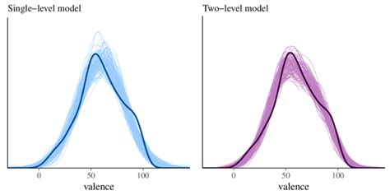
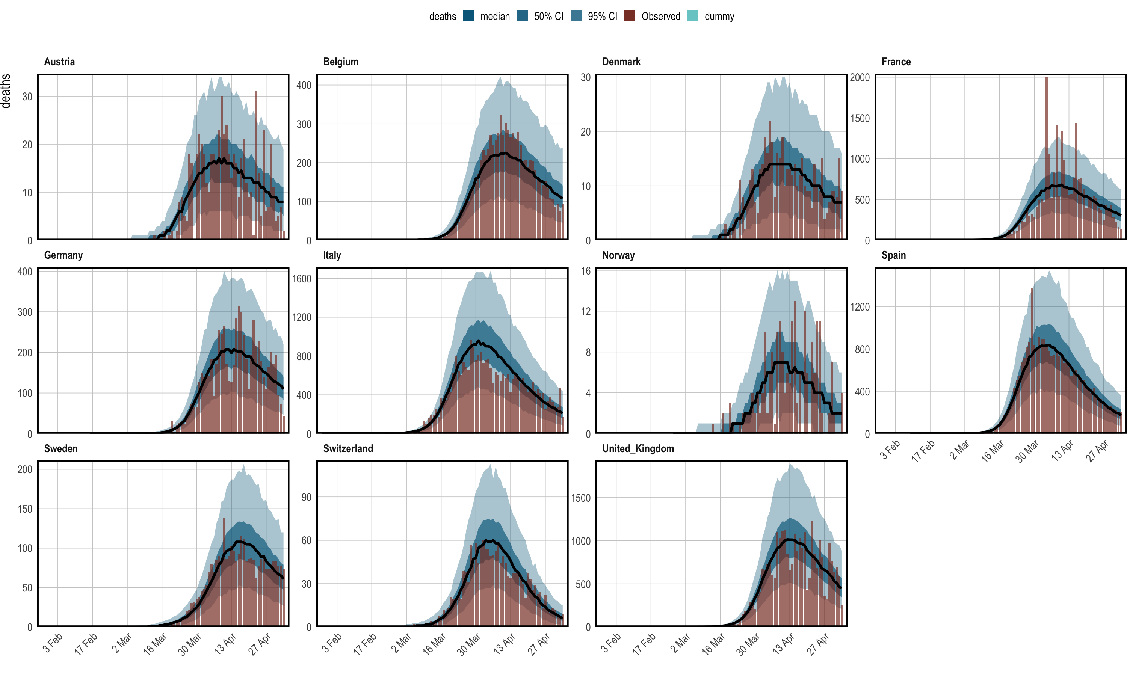
Predicción: Evaluación “formal” de un buen modelo

Slide 5
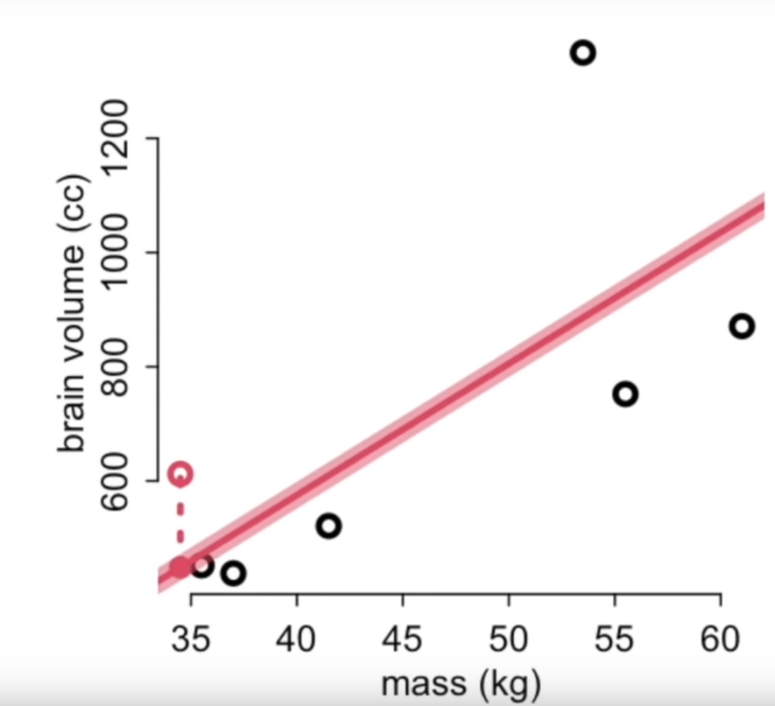
Leave-one-out (loo) cross validation
¿Qué tan bueno es el modelo para predicir el siguiente punto –nuevas observaciones-?
Tiramos un punto
Estimamos con el resto de la muestra
Predecimos el punto que tiramos -con 2-
Repetimos 1 con otro punto
Tomamos los errores de cada paso. MSE
Fuera
Dentro

Slide 6
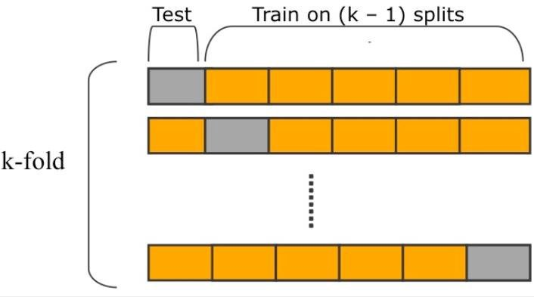
Cross-validation
How to evaluate your models out-of-sample?
Divide the sample in a number of chunks (folds). Predict each fold, after training on all the others.
How many chunks?
The maximum number of chunks (leave-one-out cross-validation)

Slide 7
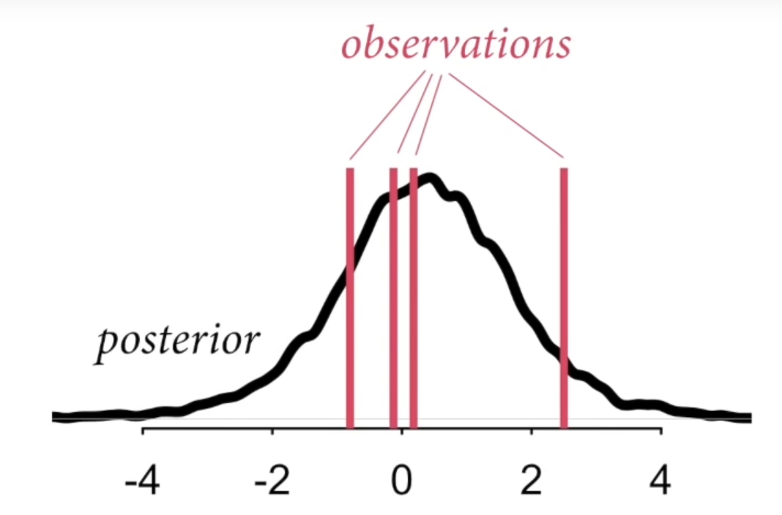
Bayesian loo and cross-validation
En Bayes no usamos puntos y una sola línea.
Usamos toda la posterior, no punto a punto
La probabilidad posterior de cada observación: la densidad predictiva de cada punto
Obtenemos posteriores para cada conjunto menos un dato
El cómputo de esto es, para todo efecto práctico, imposible!!
Pero si lo fuera ¿Cómo luciría?

Slide 8
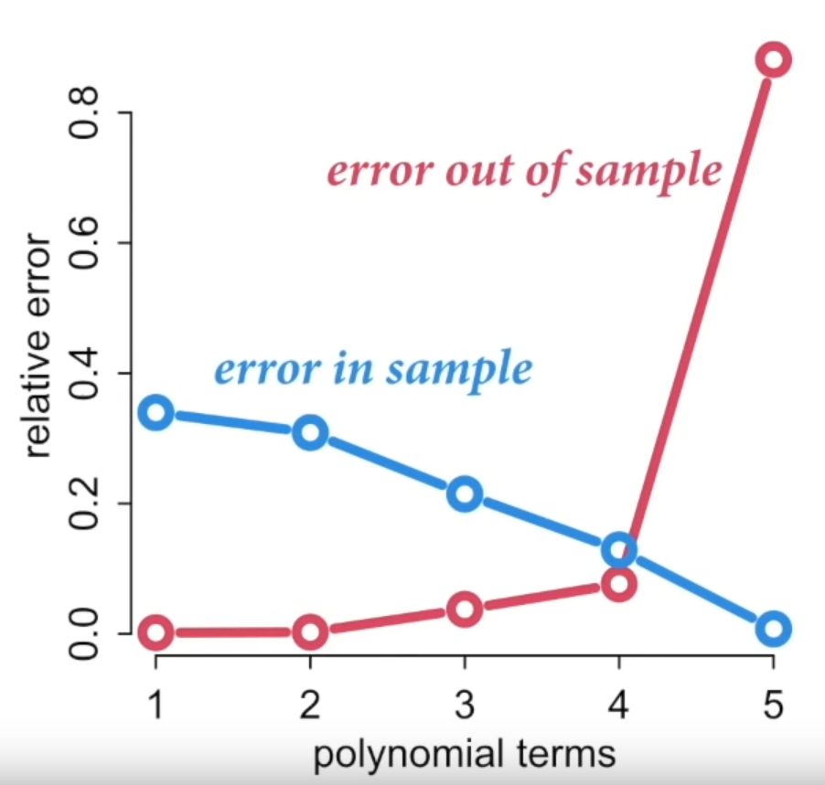
Cross-validation
Comparo distintos modelos candidatos
Error in sample > error out sample
A medida que el modelo es más complejo
, su poder predictivo fuera de la muestrea cae
Flexibilidad ~ sobreajuste!!!

Slide 9
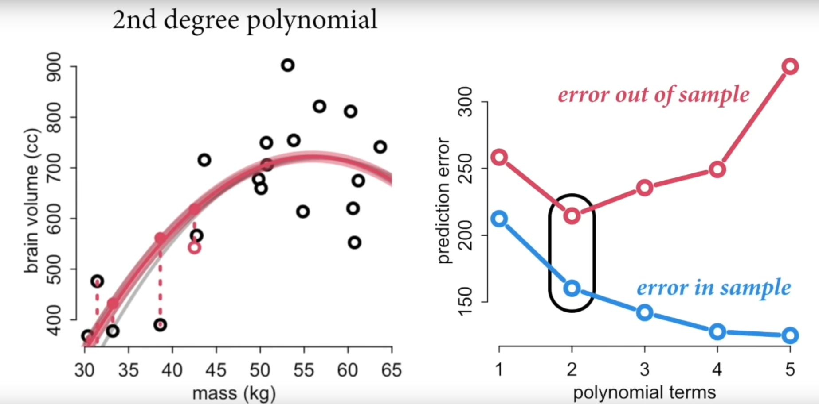
Cross-validation: fitting is easy, but prediction is hard
Cross-validation is a measure of overfitting
Regularization: function que encuentra aspectos regulares del proceso
Priors, priors, priors… reducir la flexibilidad del modelo

Slide 10
El cómputo de esto es, para todo efecto práctico, imposible!!
Cross-validation es demasiado costosa e ineficiente
¿Qué tal si podemos calcular la brecha a partir de una estimación?
Information criteria (WAIC): Widely applicable information criteria. Teoría de la información
Importance sampling (PSIS): Pareto smooth importance sampling.
Point with low probability has a strong influence on the posterior distribution

Slide 11
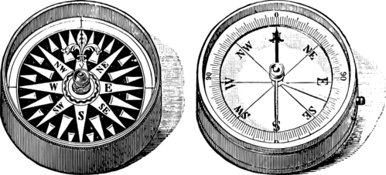


Information criteria
Implementing them is much easier tan understanding them (Information Theory)
The bit player (https://youtu.be/JP1Ljp8X6hg)

Slide 12

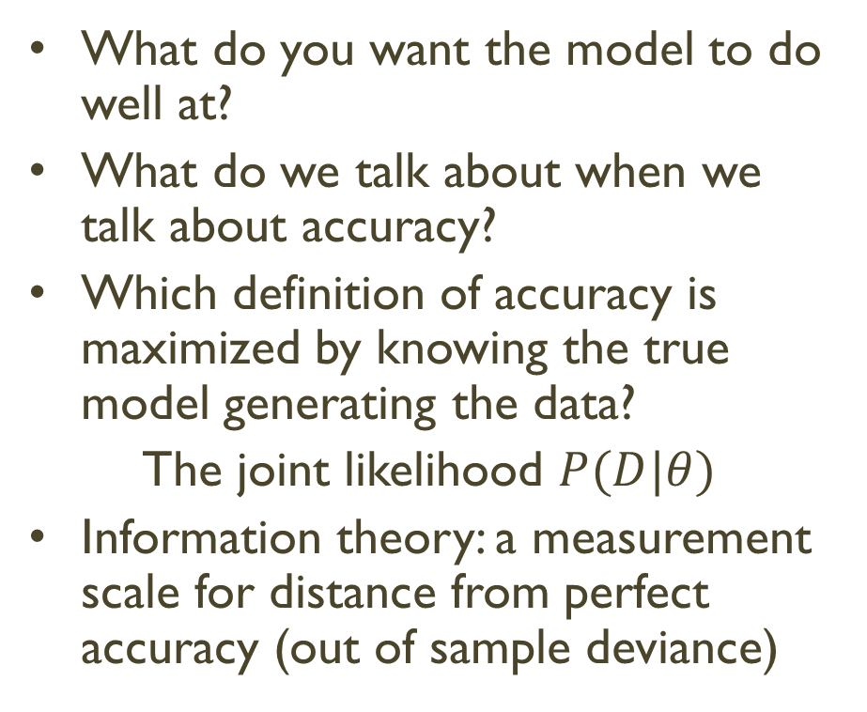
Measuring accuracy (Information Theory)
What do you want the model to do well at?
What do we talk about when we talk about accuracy?
Which definition of accuracy is maximized by knowing the true model generating the data?
The joint likelihood $P(D|θ)$
Information theory: a measurement scale for distance from perfect accuracy (out of sample deviance)

Slide 13
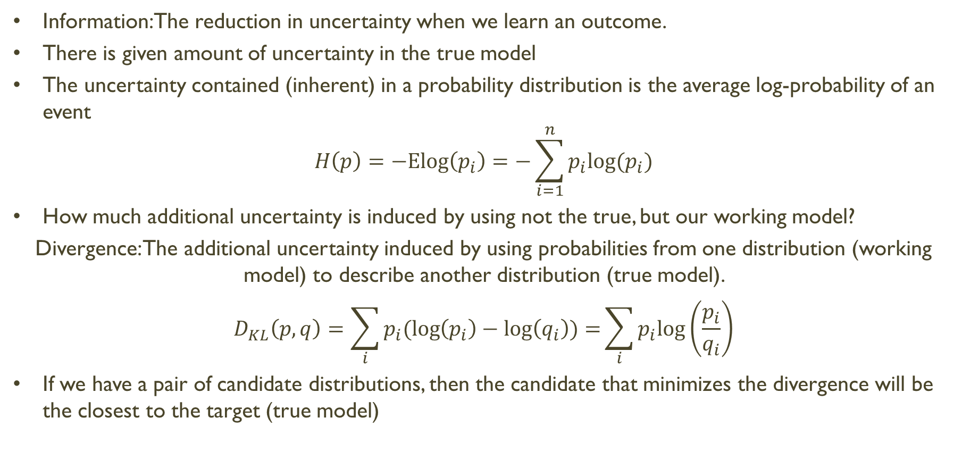
Information Entropy
Information: The reduction in uncertainty when we learn an outcome.
There is given amount of uncertainty in the true model
The uncertainty contained (inherent) in a probability distribution is the average log-probability of an event
$$H\left(p\right)=−Elog\left(p_{i}\right)=−\sum_{i=1}^{n}{p_{i}log⁡(p_{i})}$$
How much additional uncertainty is induced by using not the true, but our working model?
Divergence: The additional uncertainty induced by using probabilities from one distribution (working model) to describe another distribution (true model).
$$D_{KL}\left(p,q\right)=\sum_{i}{p_{i}(\log\left(p_{i}\right)−\log\left(q_{i}\right))=}\sum_{i}{p_{i}log⁡\left(\frac{p_{i}}{q_{i}}\right)}$$
If we have a pair of candidate distributions, then the candidate that minimizes the divergence will be the closest to the target (true model)

Slide 14

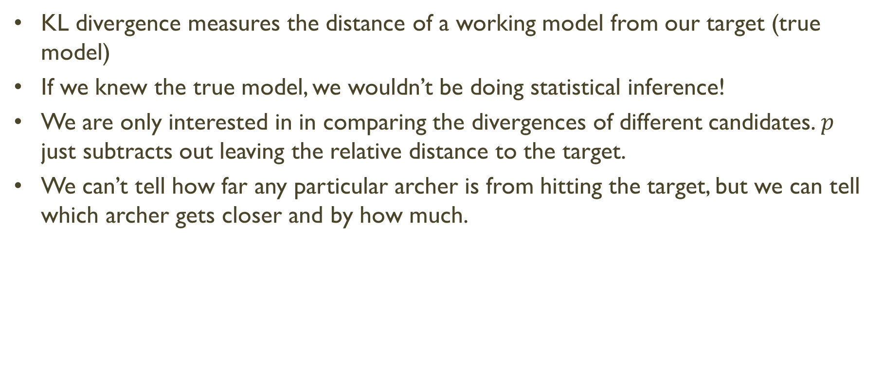
True model?
KL divergence measures the distance of a working model from our target (true model)
If we knew the true model, we wouldn’t be doing statistical inference!
We are only interested in in comparing the divergences of different candidates. $p$ just subtracts out leaving the relative distance to the target.
We can’t tell how far any particular archer is from hitting the target, but we can tell which archer gets closer and by how much.

Slide 15
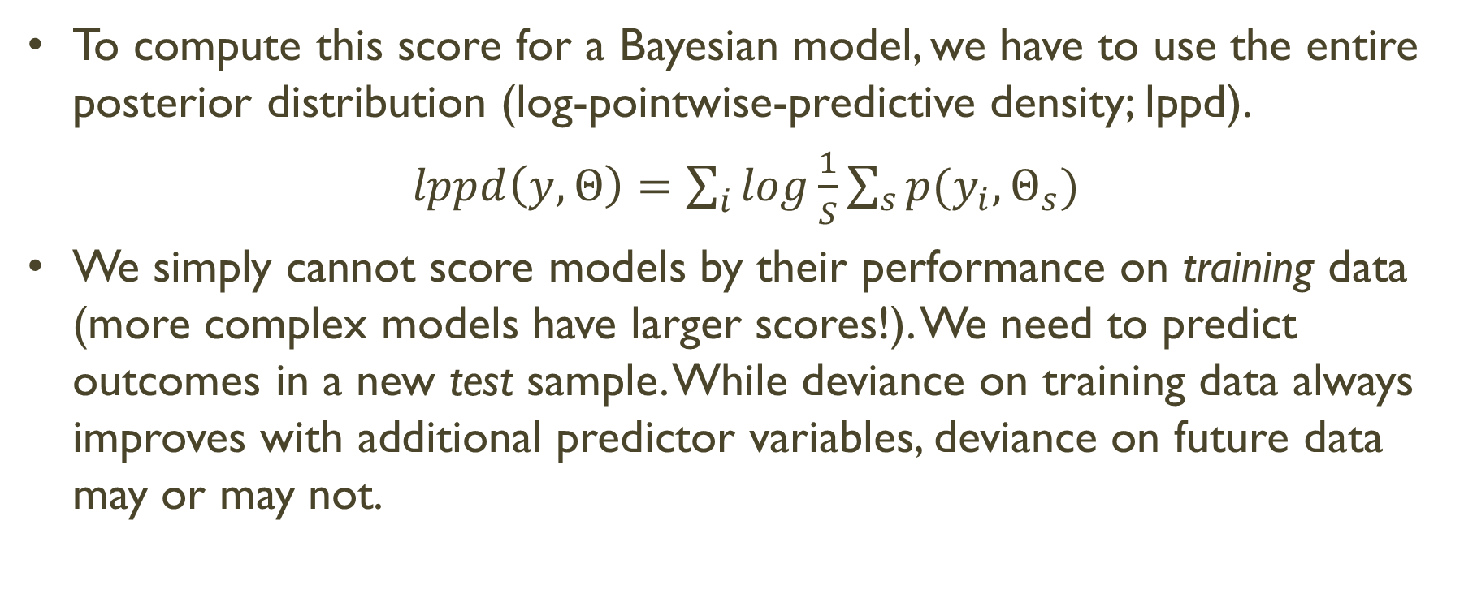
Scoring the right data
To compute this score for a Bayesian model, we have to use the entire posterior distribution (log-pointwise-predictive density; lppd).
$lppd\left(y,Θ\right)=\sum_{i}{log\frac{1}{S}\sum_{s}{p(y_{i},Θ_{s})}}$
We simply cannot score models by their performance on training data (more complex models have larger scores!). We need to predict outcomes in a new test sample. While deviance on training data always improves with additional predictor variables, deviance on future data may or may not.

Slide 16
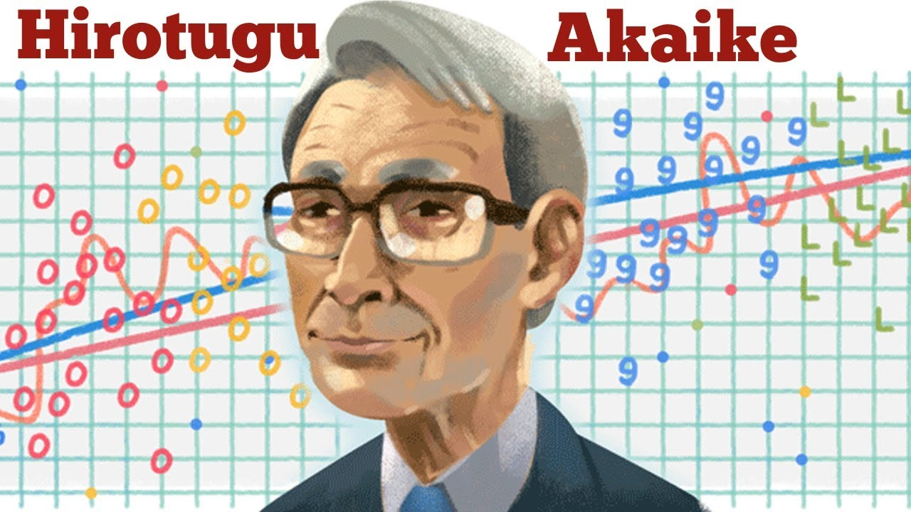
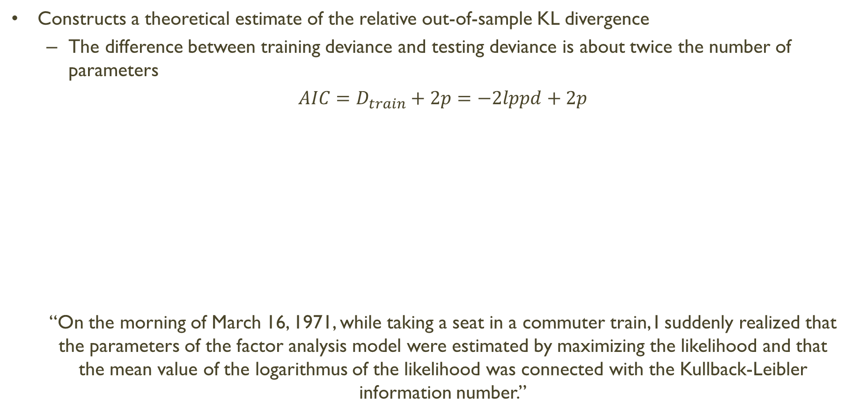
Information criteria
Constructs a theoretical estimate of the relative out-of-sample KL divergence
The difference between training deviance and testing deviance is about twice the number of parameters
$AIC=D_{train}+2p=−2lppd+2p$
“On the morning of March 16, 1971, while taking a seat in a commuter train, I suddenly realized that the parameters of the factor analysis model were estimated by maximizing the likelihood and that the mean value of the logarithmus of the likelihood was connected with the Kullback-Leibler information number.”

Slide 17

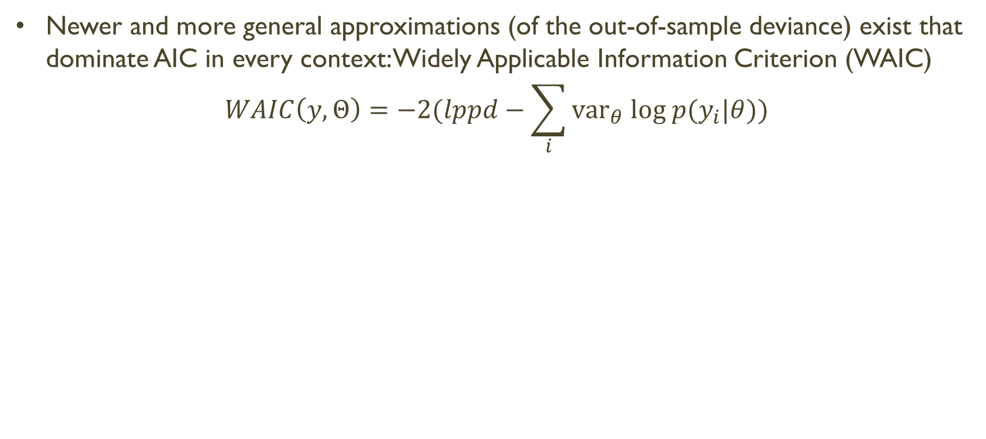
Information criteria
Newer and more general approximations (of the out-of-sample deviance) exist that dominate AIC in every context: Widely Applicable Information Criterion (WAIC)
$$WAIC\left(y,Θ\right)=−2(lppd−\sum_{i}{{var}_{θ} log p(y_{i}|θ))}$$

Slide 18
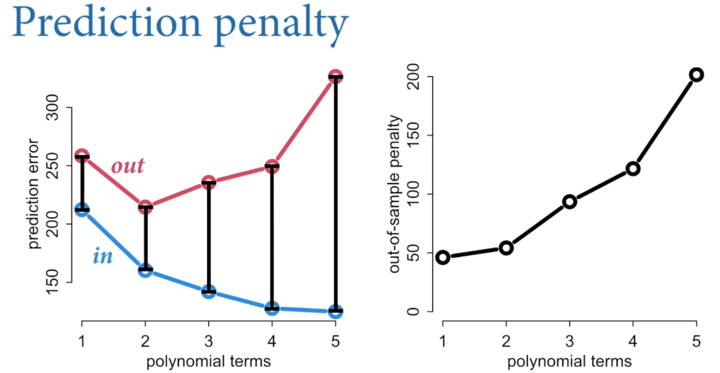
Prediction penality

Slide 19
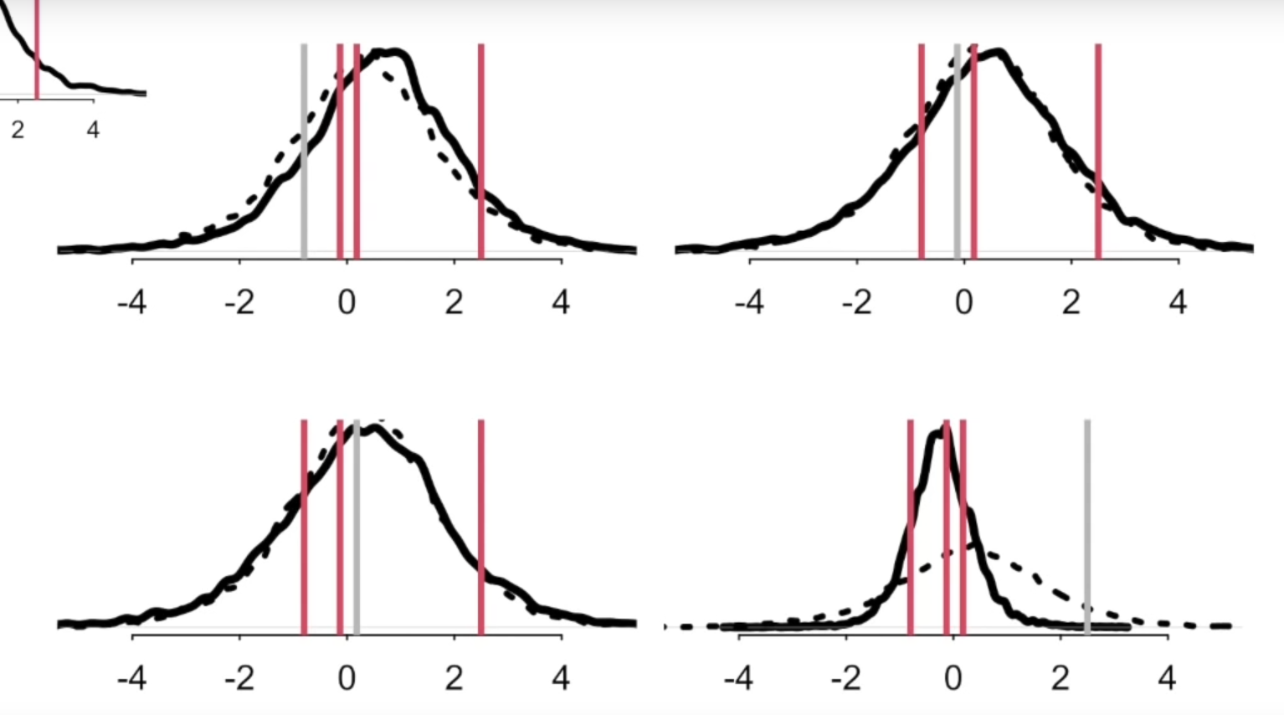
PSIS
Podemos calcular la probabilidad posterior de dicha observación e inferir la posterior resultante sin la observación

Slide 20
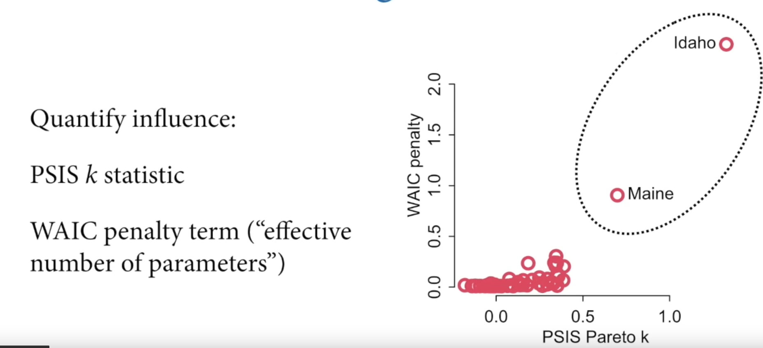
PSIS

Slide 21
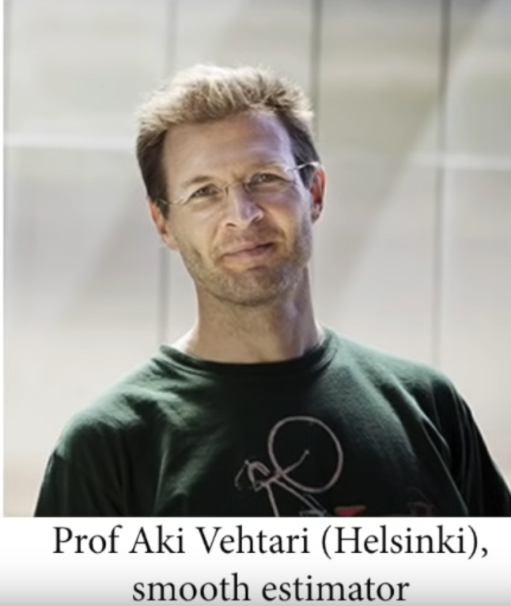
PSIS: Much more stable and provides diagnostics
Identifies outliers
Estimate of the models performance out of sample
Vehtari, A., Gelman, A., & Gabry J. (2016). Practical Bayesian model evaluation using leave-one-out cross-validation and WAIC. In Statistics and Computing, doi:10.1007/s11222-016-9696-4. arXiv preprint arXiv:1507.04544.

Slide 22
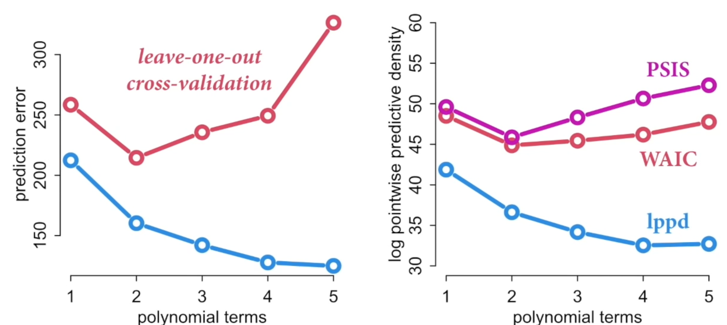
Ejemplo

Slide 23
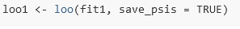
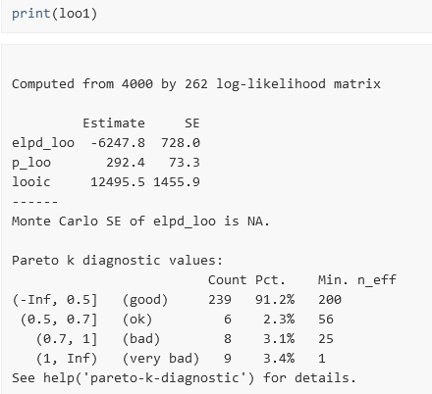
Estimación: efficient approximate loo http://mc-stan.org/loo/reference/loo-glossary.html
Cuando K pareto es largo!
P_loo < p: Mala especificacón
It describes how much more difficult it is to predict future data than the observed data!
Quisiéramos que todas fueran “buenas” <.7
Malas predicciones

Slide 24
Lecciones
NO USEN WAIC or PSIS para elegir modelos explicativos –causales-
El modelo incorrecto puede ser mejor para predecir!
¿Y los priors?
For pure prediction…. Tune the prior using cross-validation
For causal inference… use science!
Muchas tareas son una mezcla de inferencia y predicción

Slide 25
Referencias
Akaike, H. (1973), "Information theory and an extension of the maximum likelihood principle", in Petrov, B. N.; Csáki, F. (eds.), 2nd International Symposium on Information Theory, Tsahkadsor, Armenia, USSR, September 2-8, 1971, Budapest: Akadémiai Kiadó, pp. 267–281. Republished in Kotz, S.; Johnson, N. L., eds. (1992), Breakthroughs in Statistics, vol. I, Springer-Verlag, pp. 610–624
Akaike, H. (1985), "Prediction and entropy", in Atkinson, A. C.; Fienberg, S. E. (eds.), A Celebration of Statistics, Springer, pp. 1–24.
Vehtari, A., Gelman, A., & Gabry J. (2016). Practical Bayesian model evaluation using leave-one-out cross-validation and WAIC. In Statistics and Computing, doi:10.1007/s11222-016-9696-4. arXiv preprint arXiv:1507.04544.
https://www.youtube.com/watch?v=odGAAJDlgp8

